Slide 1

AA TV
Android TV Box Application

Slide 2
Current Progress (Games)
1.
2.
3.
Shuffle Cups
5.
Number Padlock
Memory Card Game
6.
Slot Machine
Color Game

Slide 3
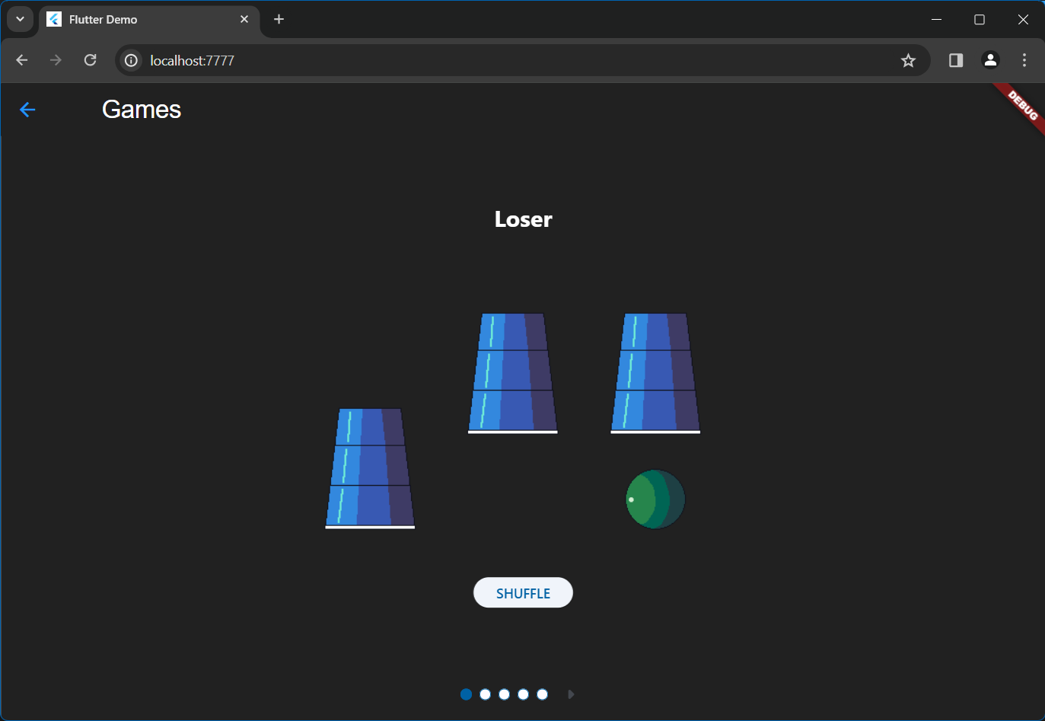
Shuffle Cups

Slide 4
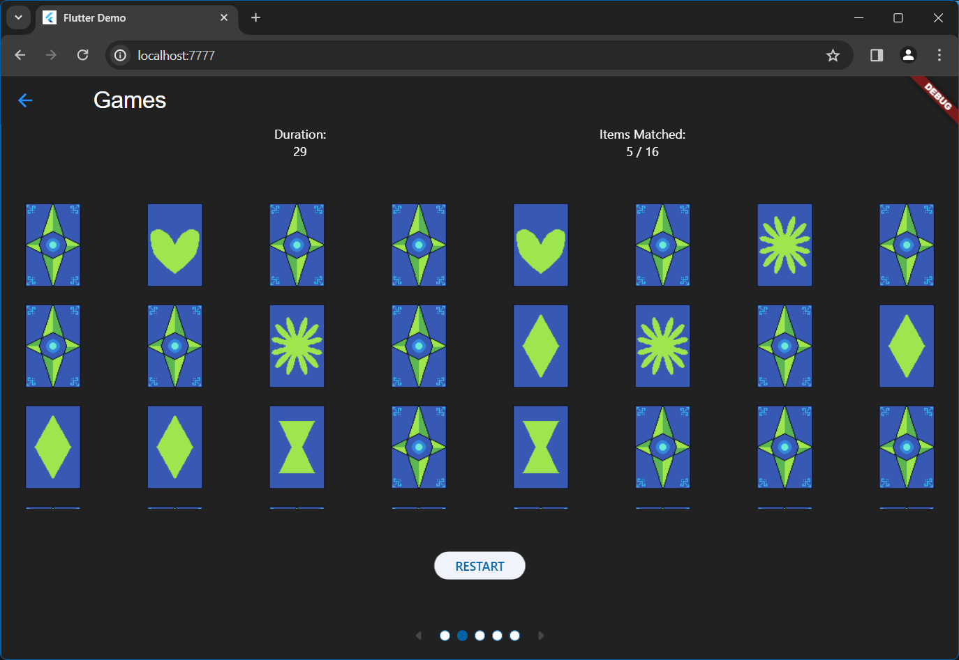
Memory Card Game

Slide 5
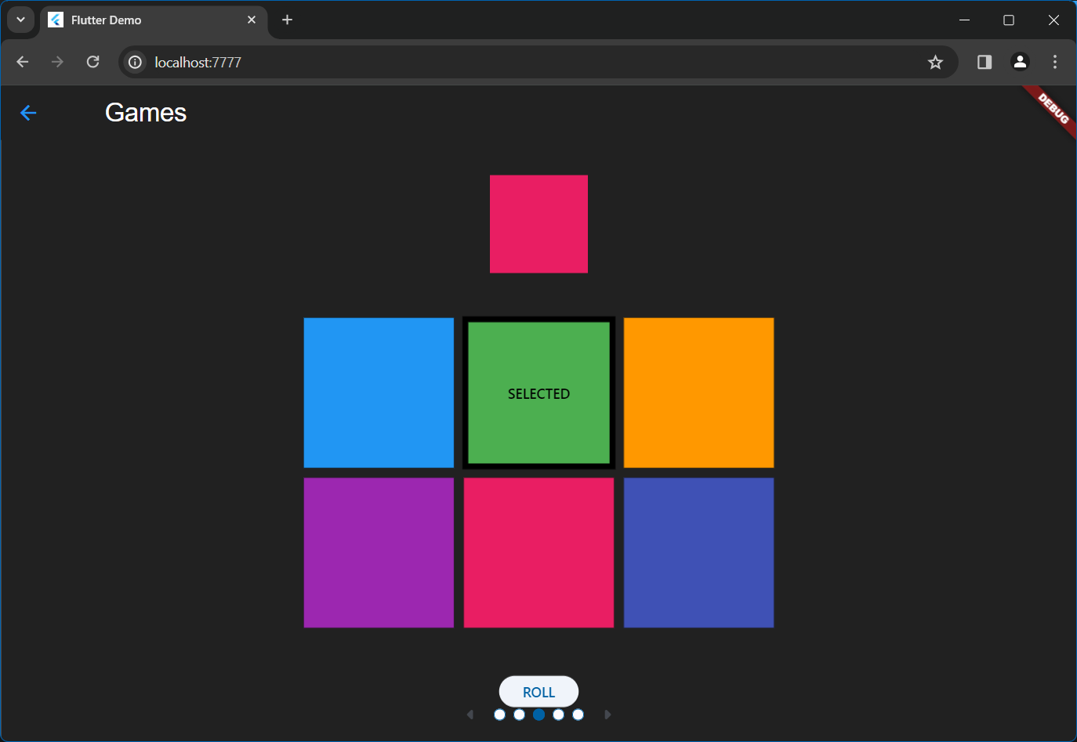
Color Game

Slide 6
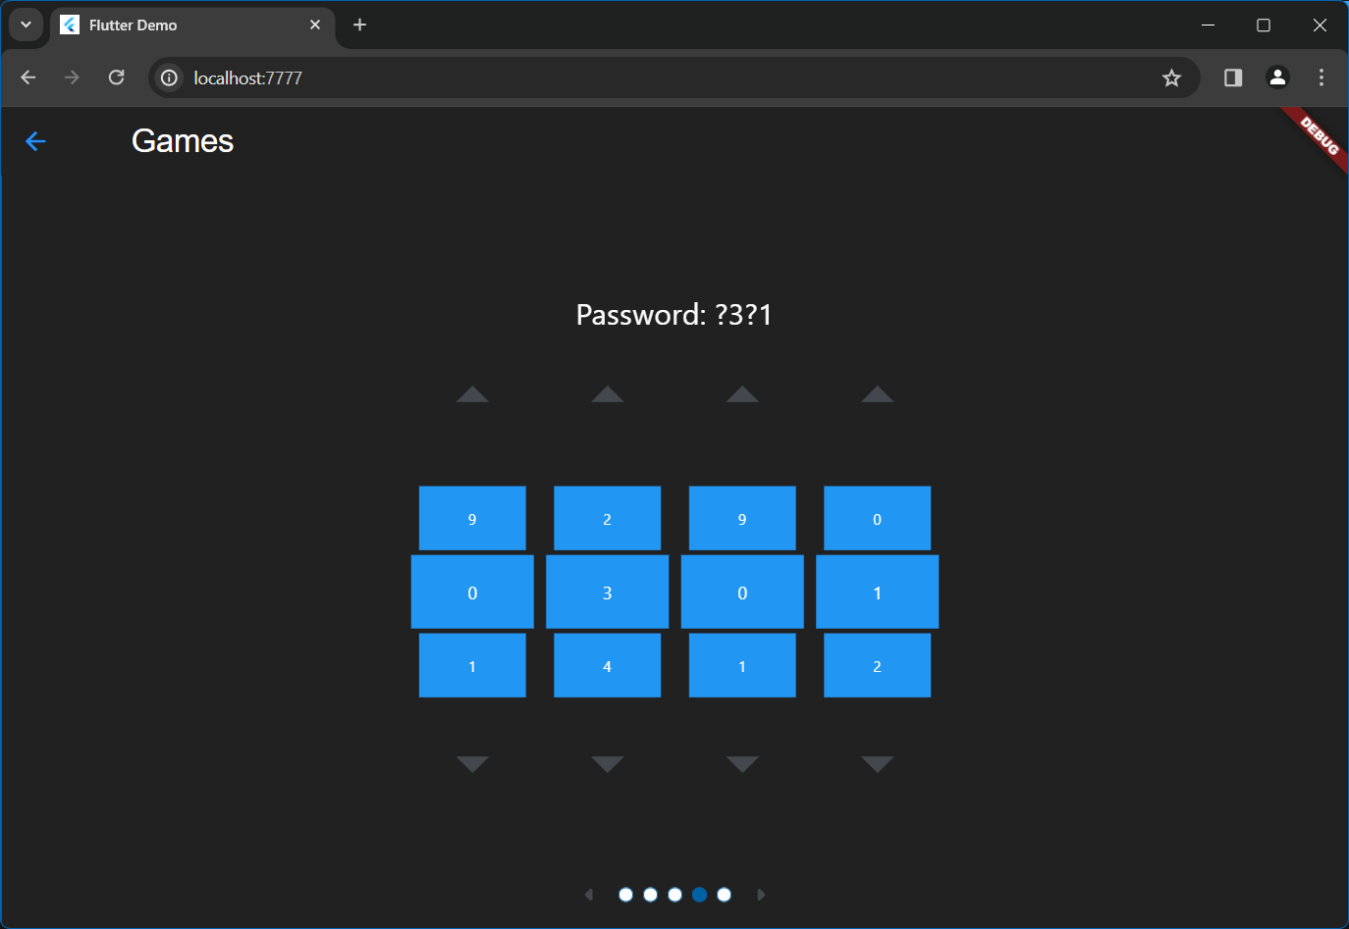
Number Padlock

Slide 7
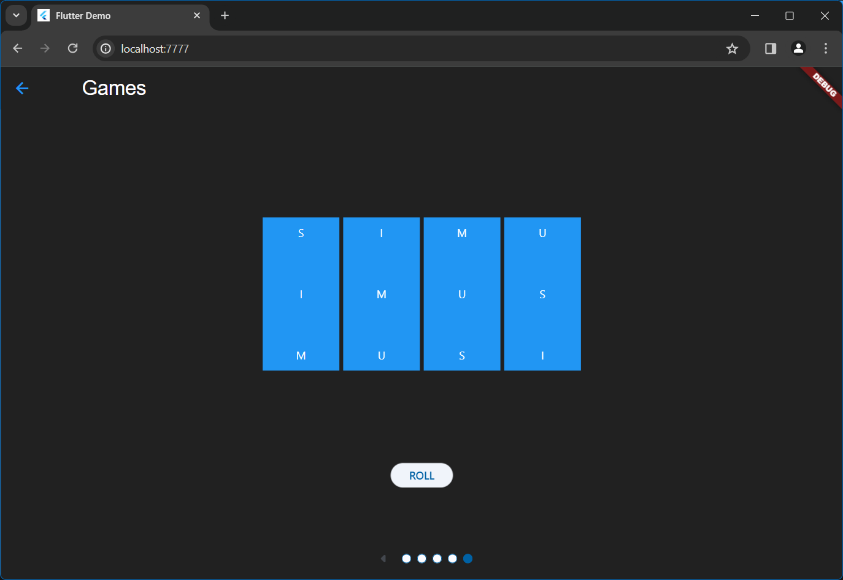
Slot Machine

Slide 8
Thank You

